Slide 1
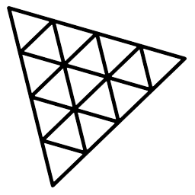
Three.js
3.JS
is
awesome
GUIDE FOR BEGINNERS
PROJECT PROPOSAL

Slide 2
TOPIC 1:
ABOUT
BUDGET
PROJECT
TIMELINE
Introduction to Three.js
PROJECT PROPOSAL

Slide 3
WHAT IS THREE.JS
WHAT IS WEBGL
TABLE OF CONTENTS
WHY THREE.JS
THREE.JS IN REACT
EXAMPLES
What is Three.js
What is WEBGL
Why Three.js
Three.js in React
Examples
01
02
03
04
05
PROJECT PROPOSAL

Slide 4

What is Three.js
What is Three.js
What is WEBGL
Why Three.js
Three.js in React
Examples
01
PROJECT PROPOSAL

Slide 5

What is Three.js
What is WEBGL
Why Three.js
Three.js in React
Examples
Three js is a 3D JS Library that enables developers to create 2D/3D experiences for Web. It works with WEBGL but you can make it work with SVG and CSS as well :
Three.js is a powerful library that many web developers are including in their projects to give their website that 3D edge.
It is incredibly easy to use but there are some pre-requisites that are;
Little basics of HTML,CSS.
Little knowledge of JavaScript.
A little basics of React JS.
PROJECT PROPOSAL

Slide 6

What is WEBGL
What is Three.js
What is WEBGL
Why Three.js
Three.js in React
Examples
02
PROJECT PROPOSAL

Slide 7
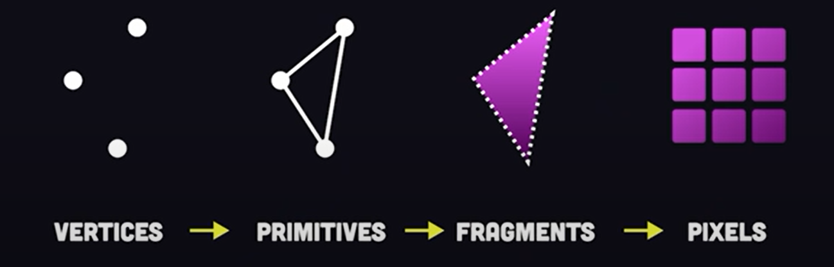

What is Three.js
What is WEBGL
Why Three.js
Three.js in React
Examples
WEBGL is a JS Application Programing Interface (API) that renders triangles in a canvas at very fast speed. It uses (Graphial Processing Unit) GPU of the user. But for native WEBGL, we use shaders and matrices which is very hard and can require 100 lines of code for just a triangle on the The canvas.
How WEBGL works:
In a 3d scene, every point is a vertex identified by
its x,y and z coordinates. The vertices are then
connected together to form a bunch of triangles
known as primitives and we use primitives to
make any shapes.
And then we use shaders and matrices.
Shaders: In WEBGL, shaders are simply programs that tells the computer how to render each pixel according to controling light, darkness and color.
Matrices: In WEBGL, Matrices are used for transformatinos of points and polygons like translation(positioning), scale(sizing) and rotation.
So it is a little hard in native WebGL to render 2D or 3D objects.
PROJECT PROPOSAL

Slide 8
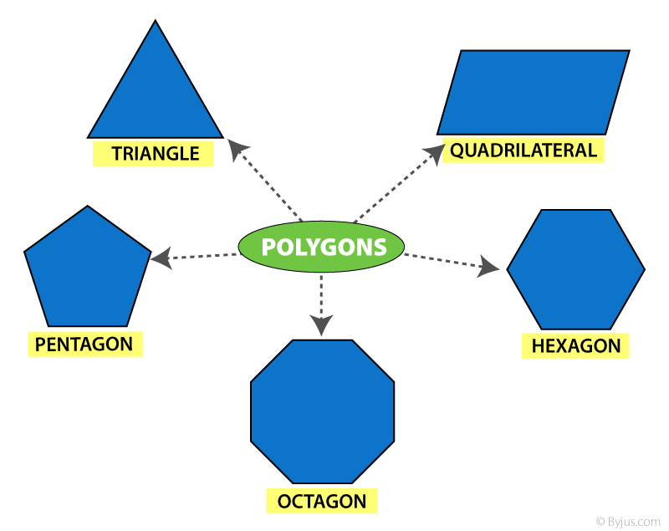
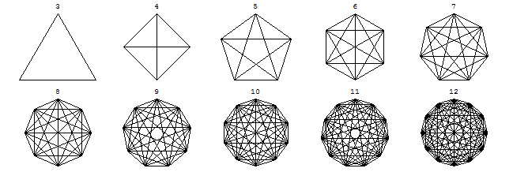
What is Three.js
What is WEBGL
Why Three.js
Three.js in React
Examples
Then we make other shapes with
triangles like polygon.
And by polygon, we can at last
make complex shapes like circle.

Slide 9
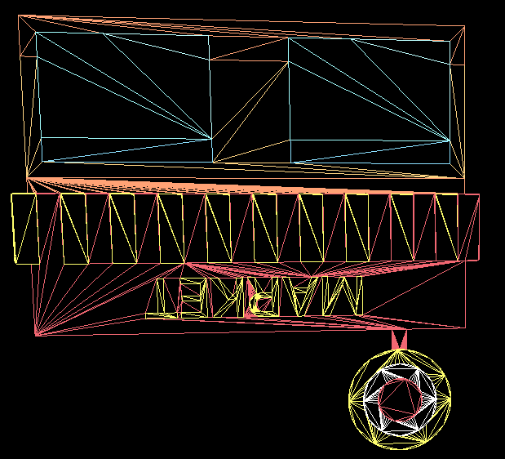
What is Three.js
What is WEBGL
Why Three.js
Three.js in React
Examples

Slide 10
Why Three.js
What is Three.js
What is WEBGL
Why Three.js
Three.js in React
Examples
03
PROJECT PROPOSAL

Slide 11

What is Three.js
What is WEBGL
Why Three.js
Three.js in React
Examples
So it is very hard to create 3D projects in native WEBGL especially for beginners. So Three.js can be a best alternative, we can use to create 3D projects in very few code of lines and we don’t have to provide shaders and matrices at every single points but can easily write
For example;
For a cube to rotate a little;
cube.rotation.x=0.3;
For a cube to move at x-axis;
cube.position.x=1;
We will still interact with WEBGL and will use shaders and matrices but will not use that for every single time.
PROJECT PROPOSAL

Slide 12
Three.js in React
What is Three.js
What is WEBGL
Why Three.js
Three.js in React
Examples
04
PROJECT PROPOSAL

Slide 13


What is Three.js
What is WEBGL
Why Three.js
Three.js in React
Examples
Advantage in React:
The good point in react is that it allows us to make component-based apps which can be reuse at any time of our project and also it is easier to use.
PROJECT PROPOSAL

Slide 14
Examples
What is Three.js
What is WEBGL
Why Three.js
Three.js in React
Examples
05
PROJECT PROPOSAL

Slide 15
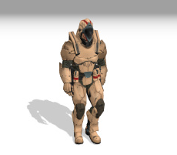
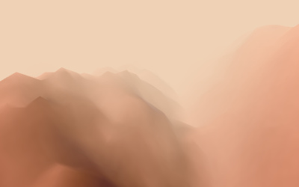
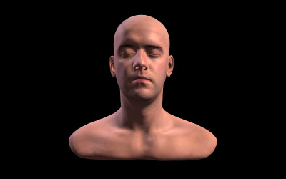
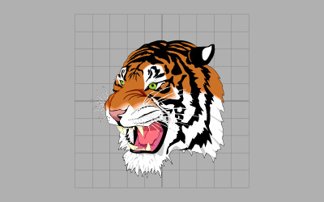
SOLDIER
What is Three.js
What is WEBGL
Why Three.js
Three.js in React
Examples
Click to view the examples below to see what can you do with Three.js
TERRAIN
The soldier can run, walk or can be in a standing position.
Click to go forward
Double Click to go backward
SKULPTURE
TIGER-2D
Click to Shoot
2D SVG loaded in website

Slide 16
THANKS!
ABOUT
BUDGET
PROJECT
TIMELINE
Do you have any questions?
EMAIL: aadnanshahh2001@gmail.com
GITHUB: https://github.com/AdnanShahSahb
Please keep this slide for attribution
PROJECT PROPOSAL

